Slide 1
Martian INvader
CYEN/CSC 132 Final Project
Group Members: Collin Corbett, jonathan Frank, john do

Slide 2
Project Overview
Create a program comprised of a password generator and puzzles
1
Create a scoring mechanism
2
Make use of GPIO’s, pygame, and GUI’s
3

Slide 3
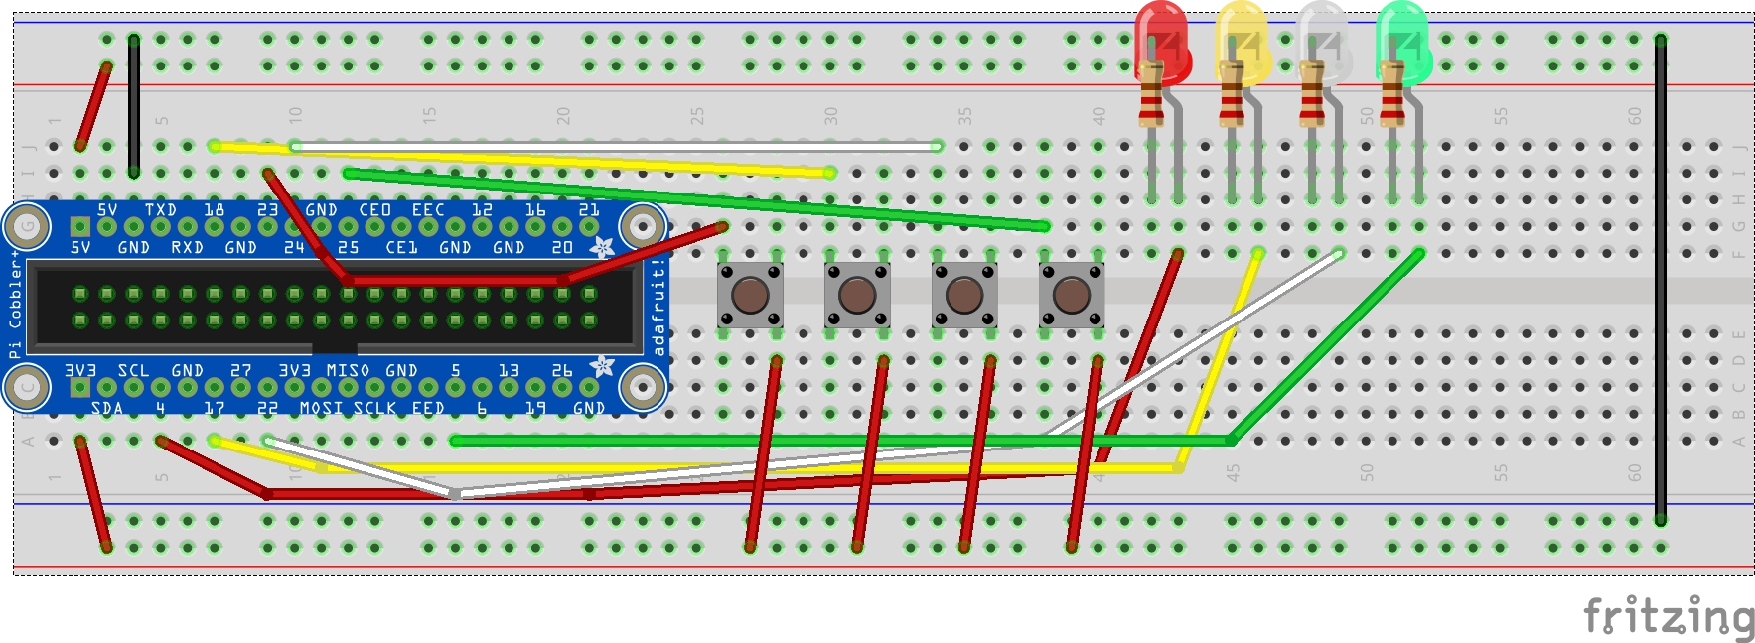
Circuit Construction
Layout Diagram

Slide 4
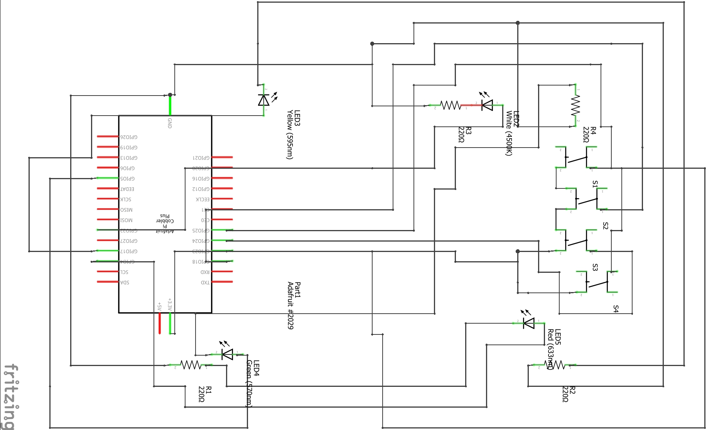
Circuit Construction
Circuit Diagram

Slide 5
Original Goals
Password Generator
Chess Style Puzzle Game
Time System
Color Sequence
GUI for inputs
Score System

Slide 6
Supply List
4 buttons
4 LEDs (different colors)
4 220 Ohm Resistors
Breadboard
16 Jumper Wires
Raspberry Pi
Adafruit Pi Cobbler Plus
Total Cost = “Free”

Slide 7

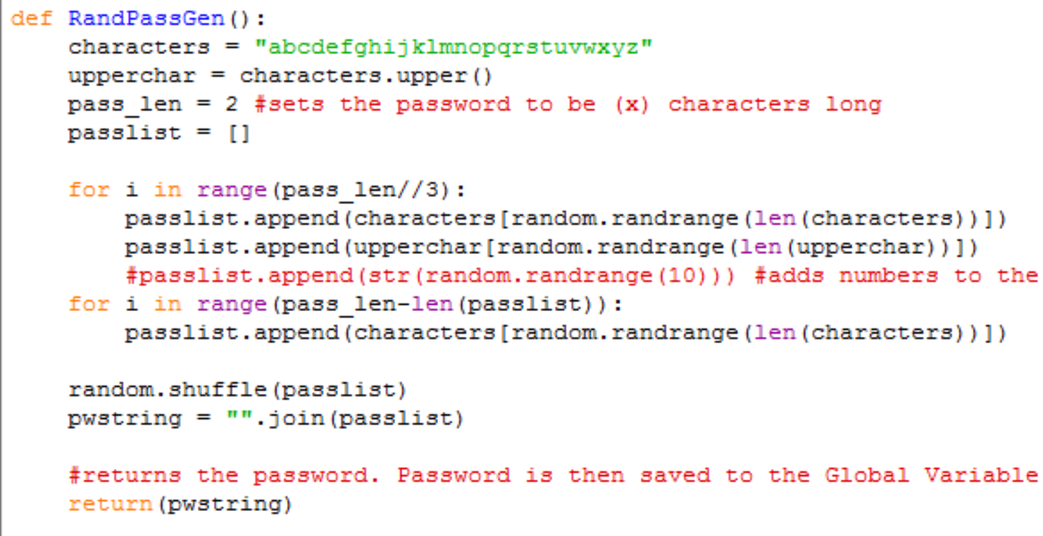
About the Program
Password Generator:
Creates a password (Duh)
Password is stored in a variable
Password is later called in PassReq() function

Slide 8

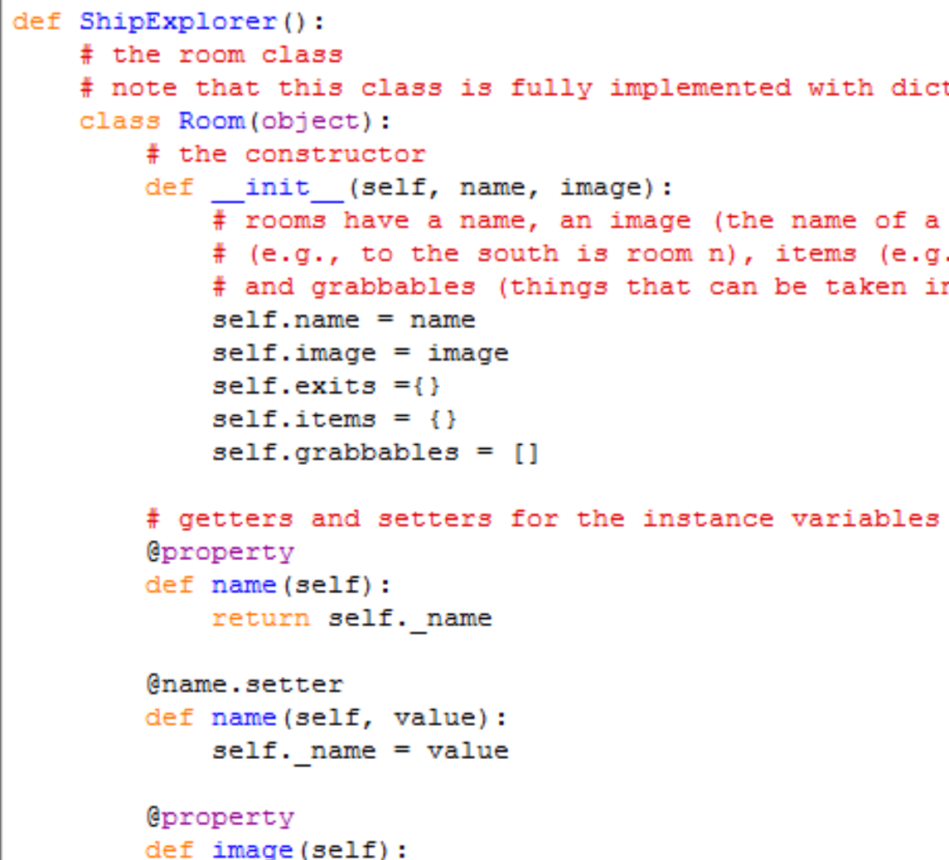
About the Program
Ship Exploration:
Generates a Ship puzzle that the player must navigate
A specific room activates the rest of the code and requests for more user input
Serves as a distraction

Slide 9
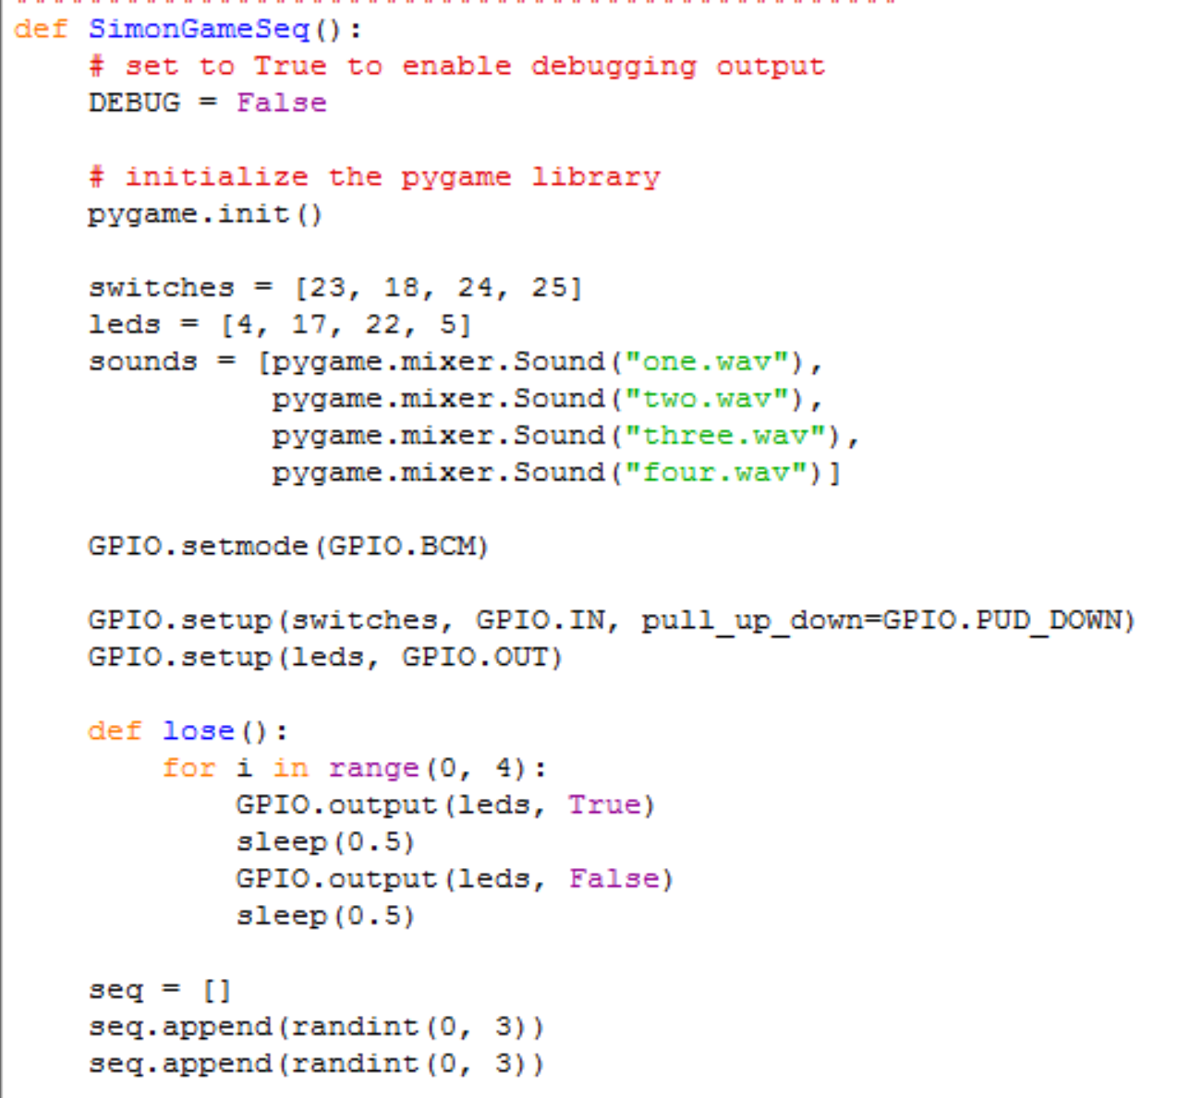
About The Program
Color Sequence
Generates a random color sequence that the user must repeat to progress in the program
Failing at the color sequence can lead to death/failure
If correctly imputed, returns the password

Slide 10
General Overview
Runs PassReq() function. Asks for user input
Correct input starts the Ship Exploration.
Once correct location is found, asks for user input

Slide 11
General Overview
Correct input starts the Color Sequence
Correct Sequence Returns the password
Correct Password wins the game/displays final prints and EndGame()
EndGame() ~ “Reward” for winning

Slide 12
Demonstration
<(o~o)/

Slide 13
What we changed
Original
Final
Chess Puzzle
Time System
GUI
Ship Explorer Puzzle
Score System
GUI/Text based

Slide 14


What we learned
What we thought:
“Python is easy!”
What we learned:
“….. You get the point.”

Slide 15
Le ENdo
*Ba dum tsssssss*
GitHub Link: https://github.com/jfrank248/final-pie-project

